Slide 1

Notice, Agenda & Minutes of Meeting
BJEL2013
ENGLISH FOR CAREER PREPARATION

Slide 2

Qualities of a Good Notice
A notice is a written or printed news usually displayed publicly. Purpose is to inform, advertise, instruct and warn.
Accurate, clear, concise and decisive.
Uses correct, unambiguous, appropriate and polite language.
Has short words and sentences.
Uses an attractive layout
Carries separate paragraph for each separate idea.
Be reader-friendly – appealing, convincing and understandable.

Slide 3
NOTICE OF MEETING
A meeting notice contains following items:
Name of organisation
Place of meeting
Date and time of meeting
Purpose of meeting
Note:
Notices are usually sent within 2 weeks
Can be in different forms (e-mail, SMS, memo)

Slide 4

AGENDA
An agenda is a list of items to be discussed at a meeting.
Prepared by the Secretary of the organization/committee in consultation with the chairperson
Distributed to the members before the meeting
Signed by the Secretary
The list of items should be arranged in logical manner.

Slide 5
Standard Format of Agenda
Heading: the name of the body holding the meeting, place of the meeting, date and time of the meeting
Apologies for absence
Minutes of previous meeting
Matters arising: only minor items
Chairperson’s items
AOB: it’s necessary to give members a chance to discuss matters arising after the agenda was prepared.
Date of next meeting: the date convenient to majority of members is chosen
Chairperson’s agenda has sufficient space between items to take notes during the meeting

Slide 6
Advantages of Agenda
Confirms the date, time and place of meeting
Directs the course of meeting
Prevents digressions (diversions)
Gives members time to think, form or seek opinion or collect information
Helps members to come with sufficient background information

Slide 7
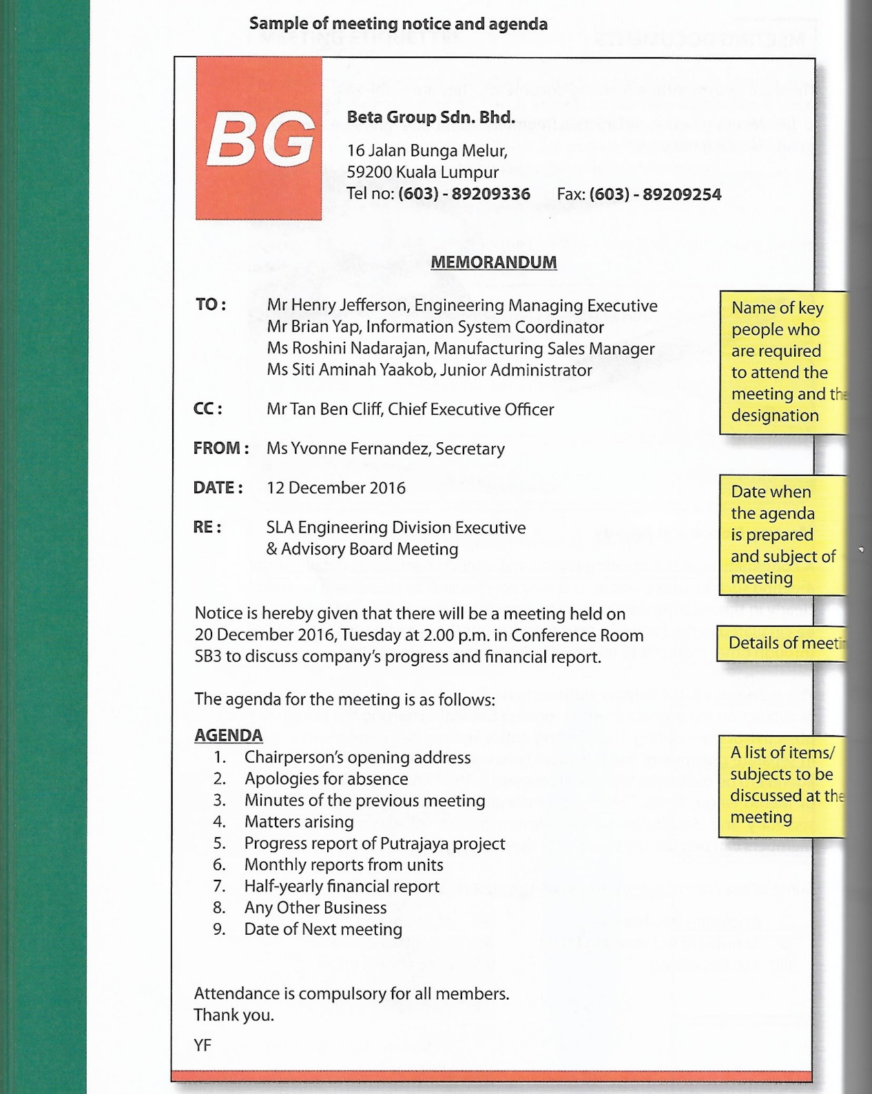

Slide 8


MINUTES OF MEETING
The official record of discussion held and decisions taken at a meeting are called as minutes.
Generally written by the secretary of the committee and signed by both the secretary and the chairperson.
Notes:
‹#›

Slide 9
Format of Minutes
Name of the organisation
The date, time and place of meeting
Name of the chairperson and members present, of those who could not attend
Minutes of the last meeting; whether they were read, confirmed and signed.
Subjects discussed: summary of discussion and decisions taken
Date of the next meeting
Signature of the secretary and the chairperson.

Slide 10
Importance of Minutes
serve as an aid to memory
provide a basis for action
a way to share what happens with members who don’t attend
a way to prevent disagreement over member assignments and group decisions
act as a means of informing the absent members, about the discussion held and decisions taken in the meeting

Slide 11
After the Meeting
Type up / edit the minutes as soon as possible, preferably within 48 hours
Double check for grammatical and spelling errors
Make sure you have the minutes approved by the Chair before distributing them

Slide 12
